Slide 1
SkyDoc™ Systems Aerostat
Launch/Recovery Unit
“TheBox”
www.skydoc.com

Slide 2
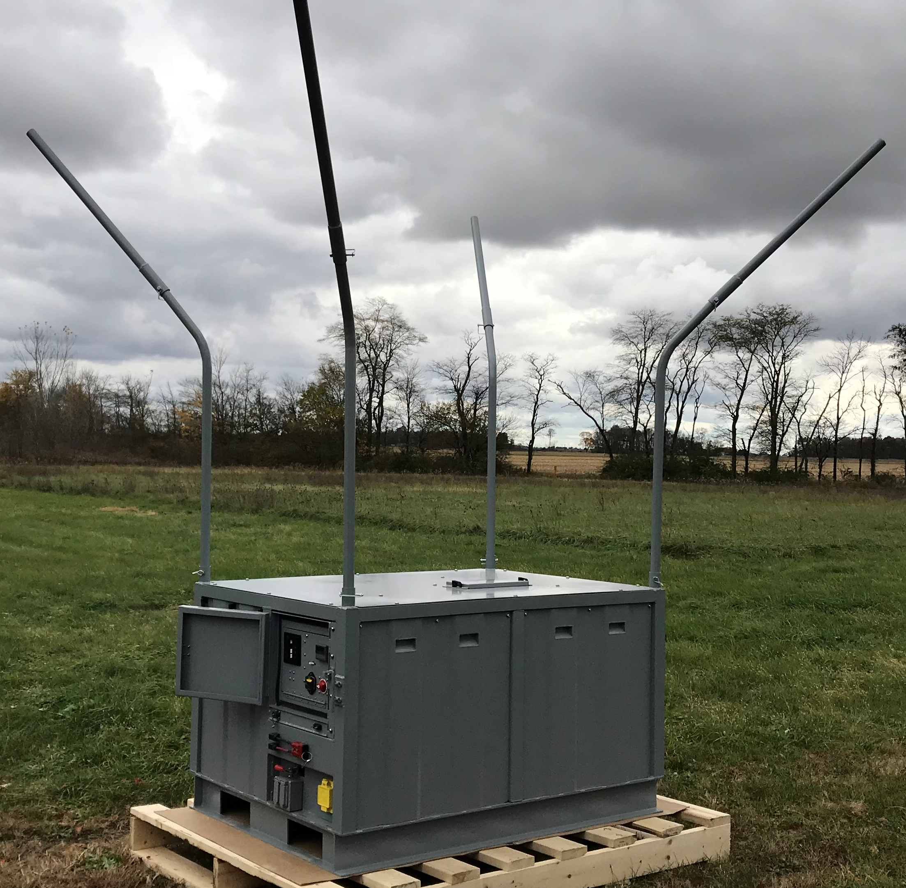
TheBox can be on a fixed pad, in the rear-bed of a pick-up, on the aft deck of a naval or civilian ship, coastal patrol vessel, and to the top of a building.

Slide 3
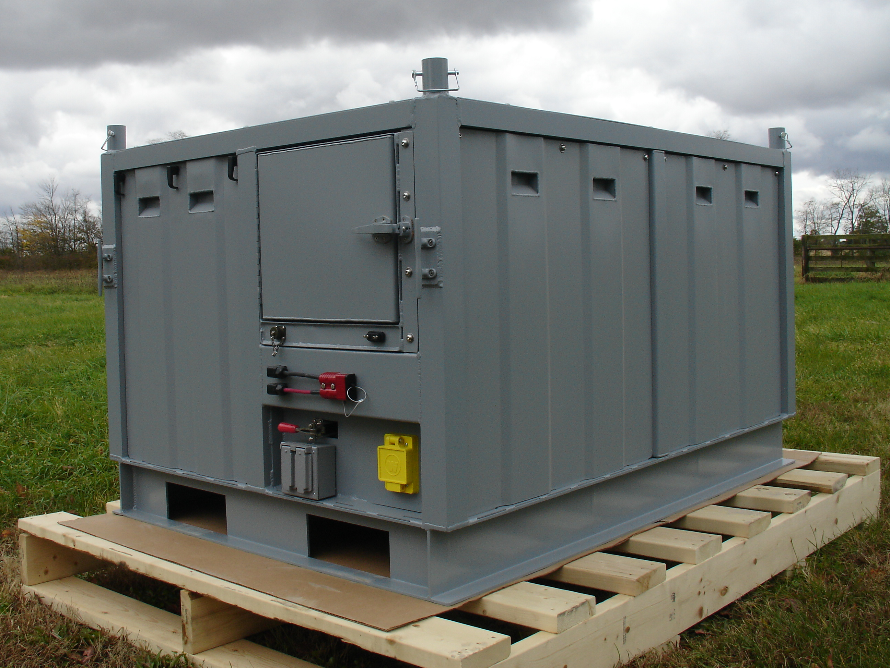
TheBox ready for transport.

Slide 4
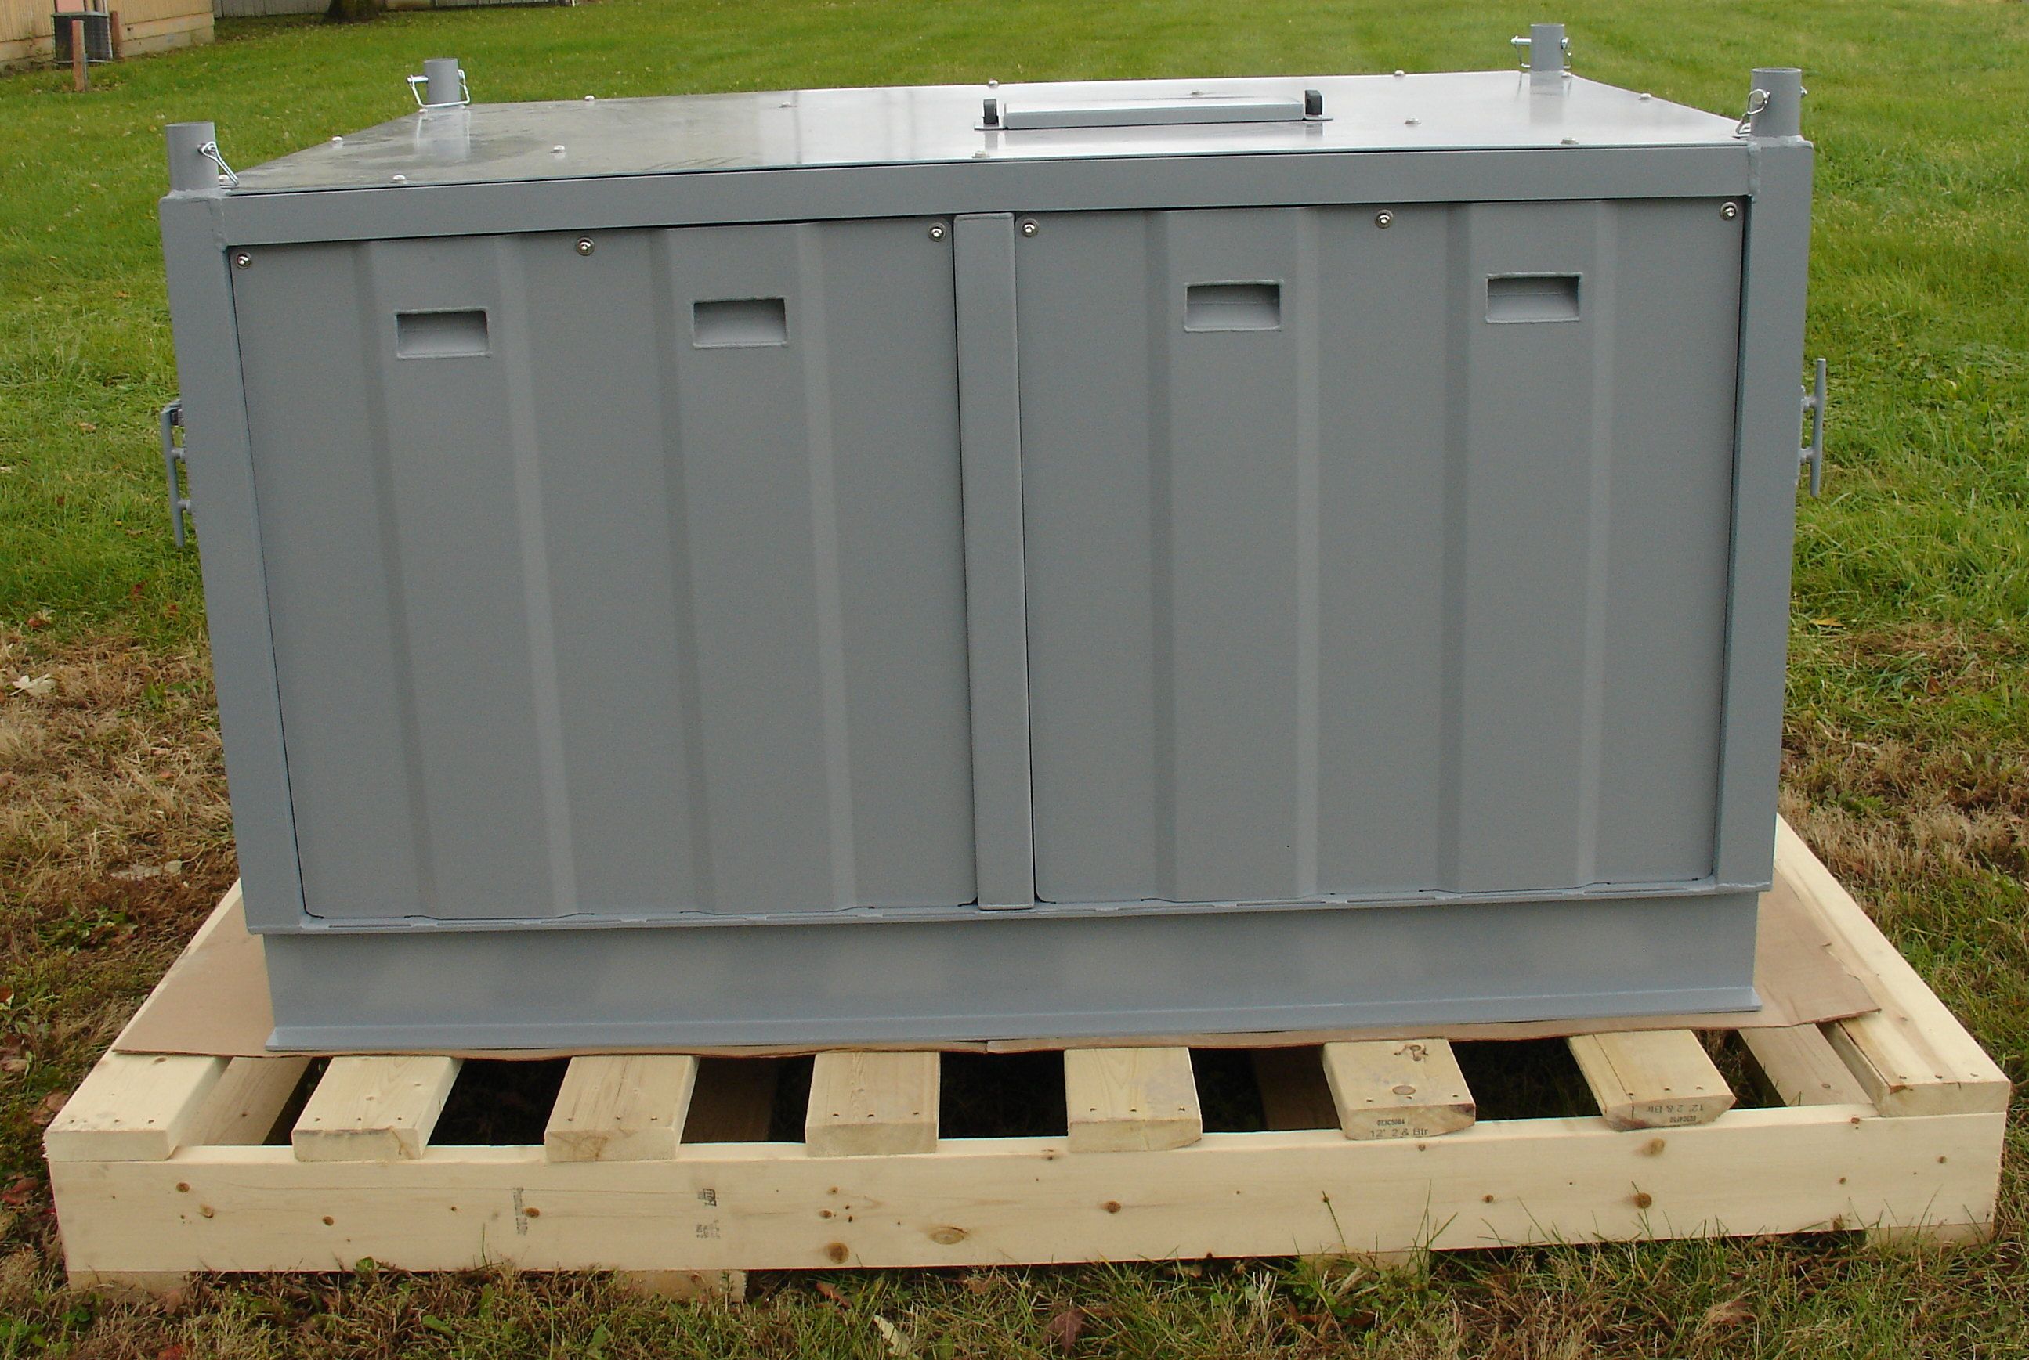
Vertical winch operations through access port on top of TheBox.

Slide 5
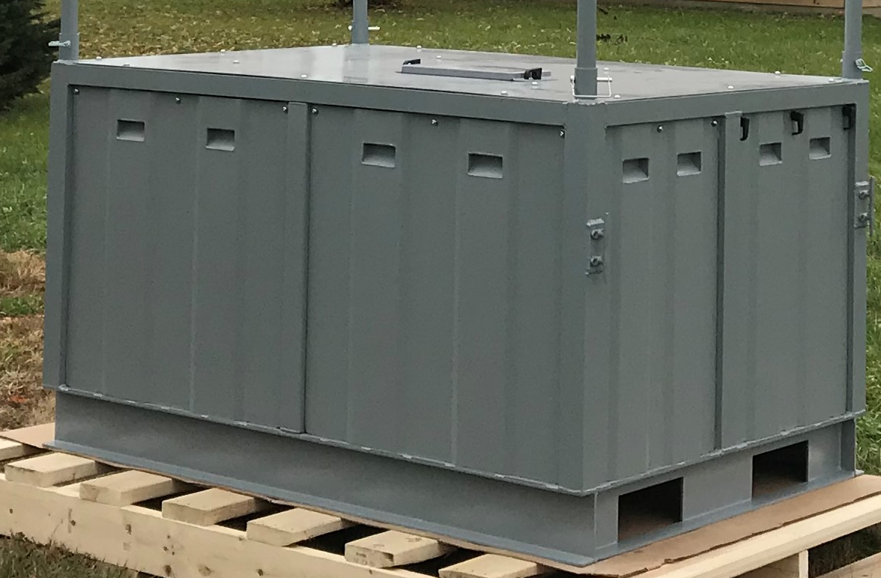
Right side quick access to storage of four Helium bottles.

Slide 6
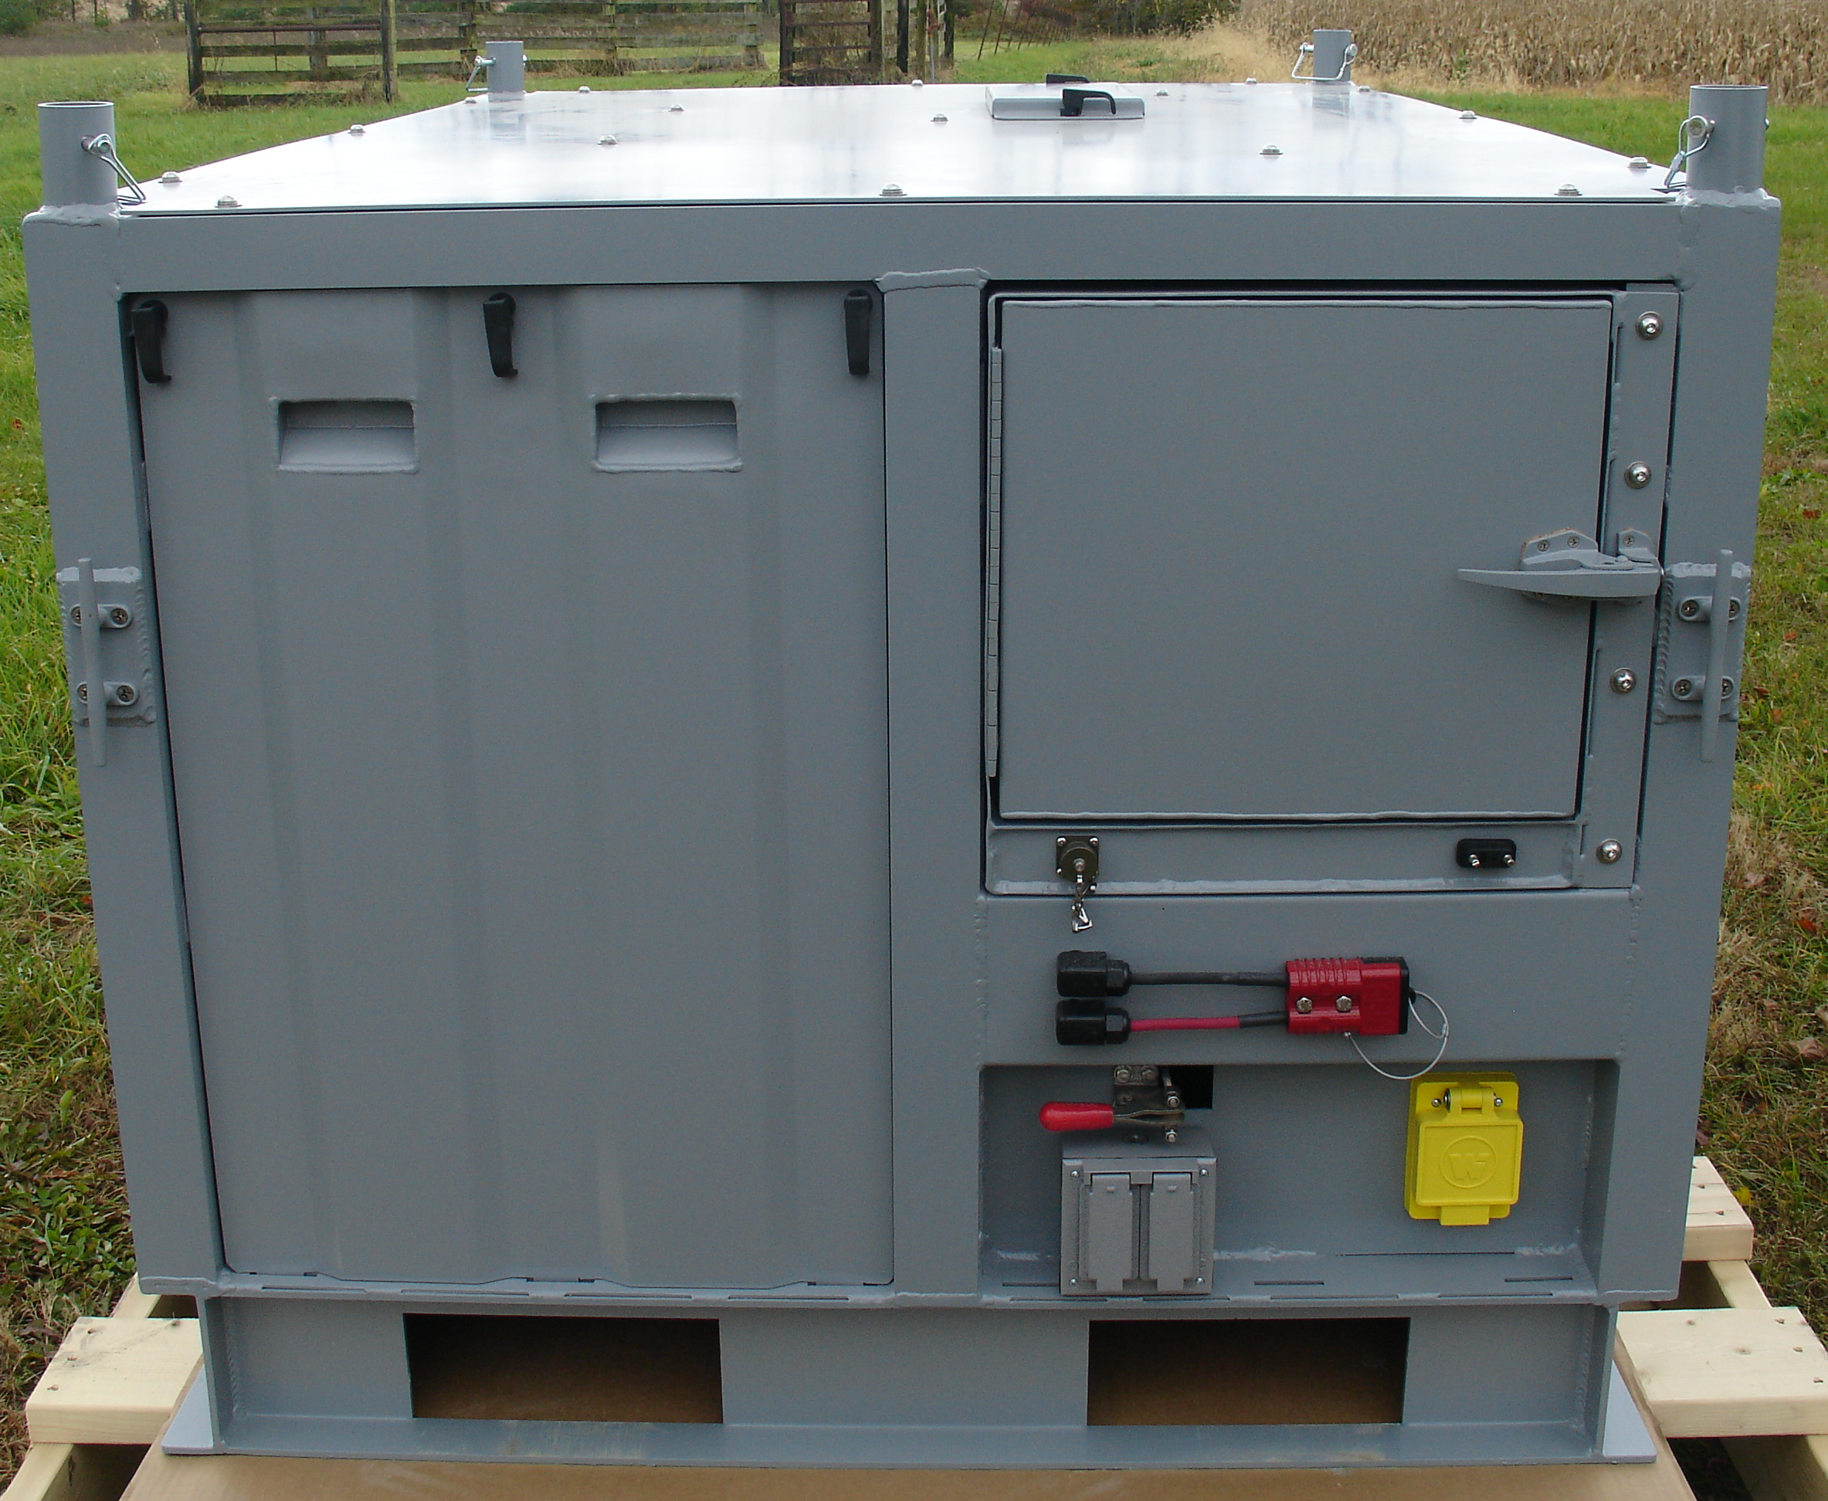
Left side quick access for cradle support rails.

Slide 7
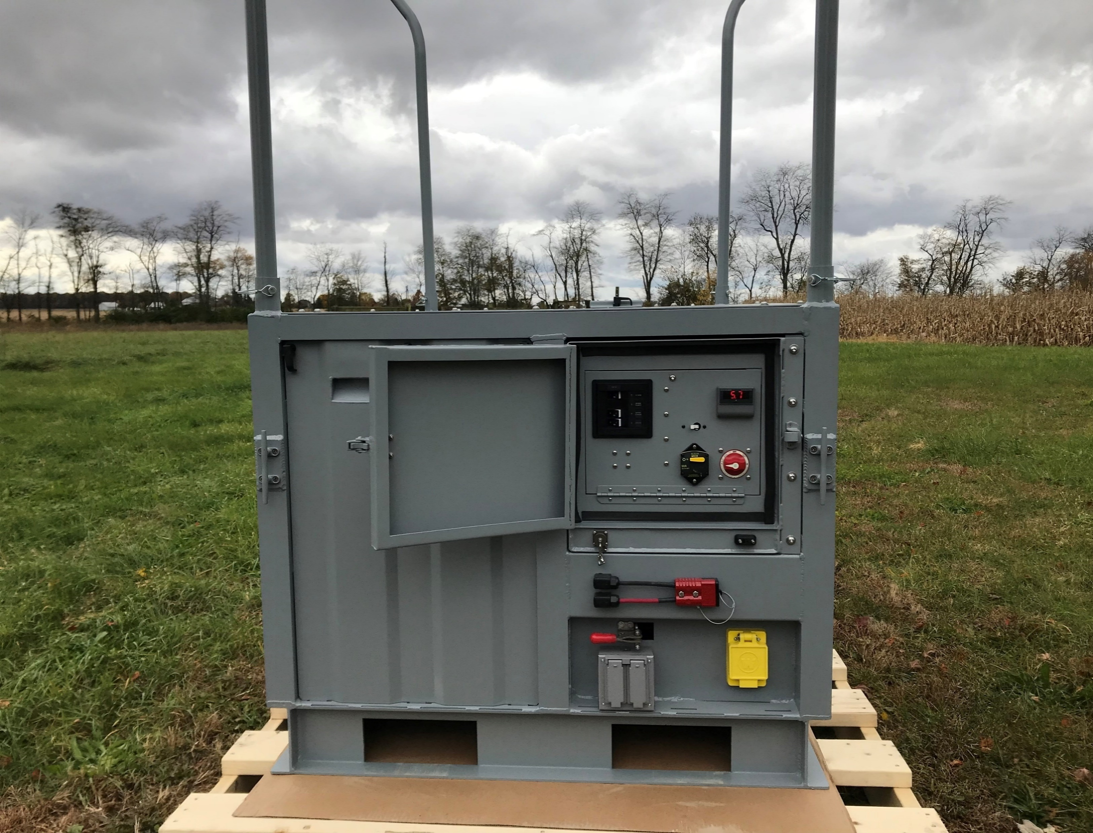
CONTROL PANEL
Left Side Right Side
30A AC Main DC Voltmeter
Reverse Polarity
15A Battery Charger
15A Outlets
10A Drum Breaker
50 amp 24vdc breaker
Battery Selector Switch
Remote winch control
DB9 Comm Port
External 24V Battery Input
Emergency Brake
120V AC Input plug
External Outlets

Slide 8
Skydoc™ Systems, Inc.
For information and availability of our complete line of products please visit us at our web site or call anytime.
Office/Cell: 503 396 8417
www.skydoc.com

